Slide 1

ENGEERING GRAPHICS AND INTRODUCTION TO DIGITAL FABRICATION
COURSE CODE : BME01T1001. Session :2021-22
SEMESTER:02

Slide 2
TOPIC: HEAD SOCKET SCREW BOLT Submitted by : SUBMITTED TO:LAV PREET SIR, MD RIZWAN AHMAD: 21SCSE1010811 NITESH KUMAR:21SCSE1010954
INTRODUCTION:
What is head socket screw bolt?
Socket Head Cap Screws, which are also known as Allen head screws are stock items at Lightning Bolt in many materials sizes. These screws come with a hexagonal cross-section socket in the head and require an Allen wrench or hex key to drive them into material and secure them into a structure.
USES:
Allen key, is a simple tool used to drive bolts and screws with hexagonal sockets in their heads.

Slide 3
ABSTRACT
Steps to create sketch socket screw bolt:
Step 1:Choose the top plane and make circle with the diameter 9mm.
Step 2: Then extruded .
Step 3: Then select the down side, and make a circle with the diameter 5mm.
Step 4: Choose fillet option and put it with the parameter 2.50mm.
Step 5: Then we have to drill the upper side of the bolt.
Step 6: Choose the hole wizard option and select type of hole and also size.
Step 7: Then click ok .

Slide 4
Step 8: Then we have to put allen key, select the origin size and shape of the allen key with the diameter 3.2mm .
Step 9: Click on ok.
Step 10: After allen key shape we have to make thread on the bottom side.
Step 11: Choose the option hole wizard and click on thread .
Step 12: And select the thread location the bottom side the bolt.
Step 13: Then select the face {1}.
Step 14: In specification select the type of tap{metric tap}.
Step 15: Choose the type of thread mode {extrude thread}.
Step 16: Then again select the thread option and edit .
Step 17: Click on offset with size 3mm direct outward.
Step 18: Then select the inner circle and make another circle with the diameter 7mm.

Slide 5
Step 19: For cutting the external size of the thread .
Step 20: Choose extruded cut and change the direction by {through all option}.
Step 21: Click ok and the allen bolt is ready

Slide 6
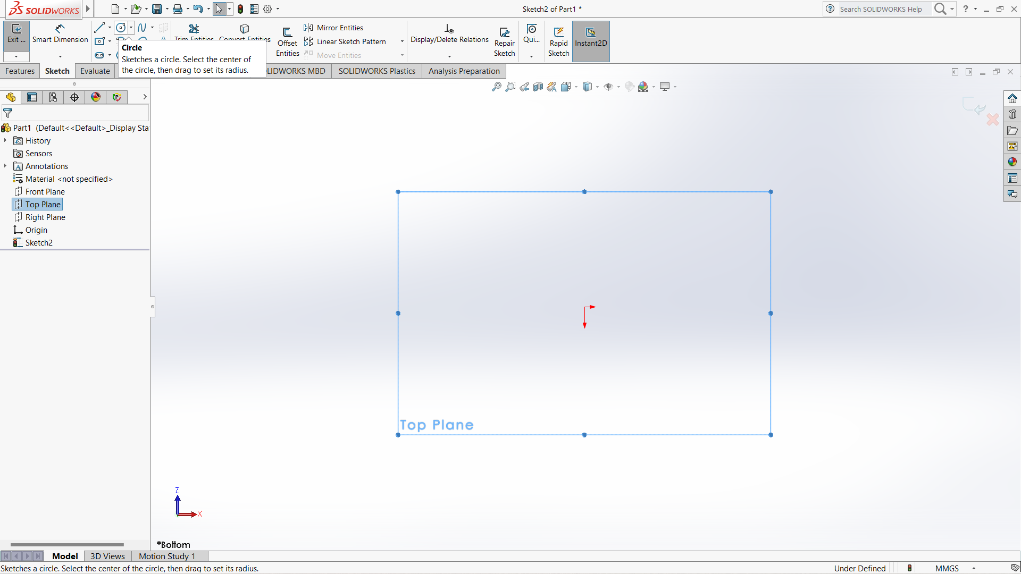

Slide 7
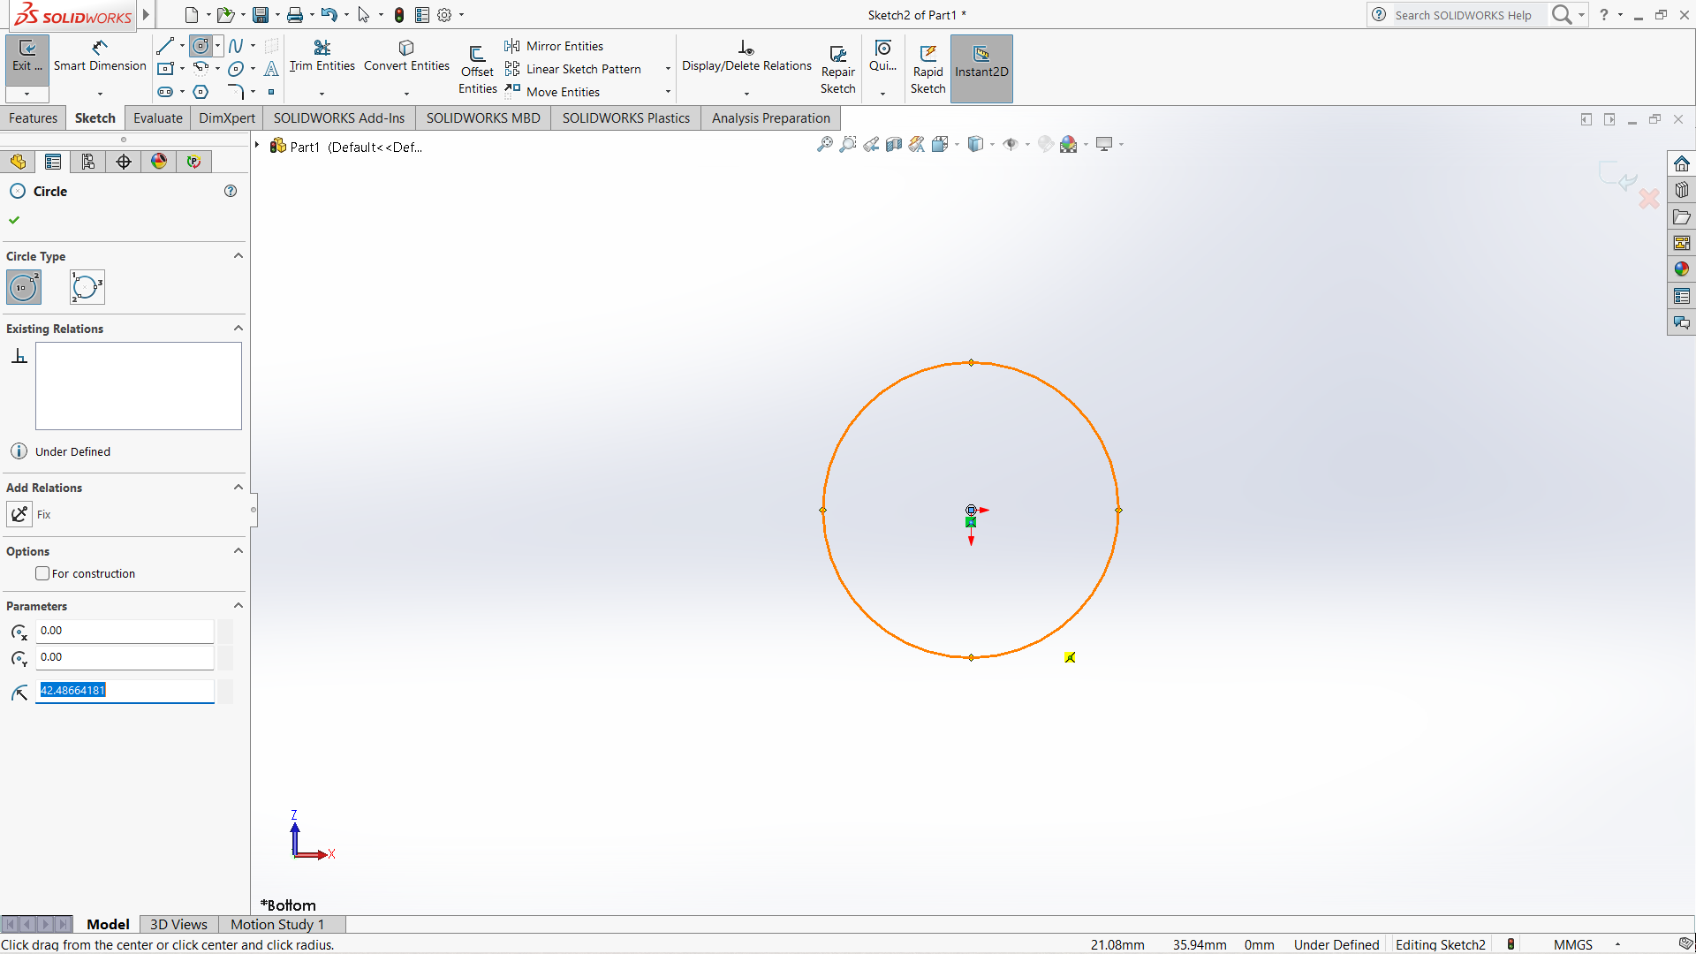

Slide 8
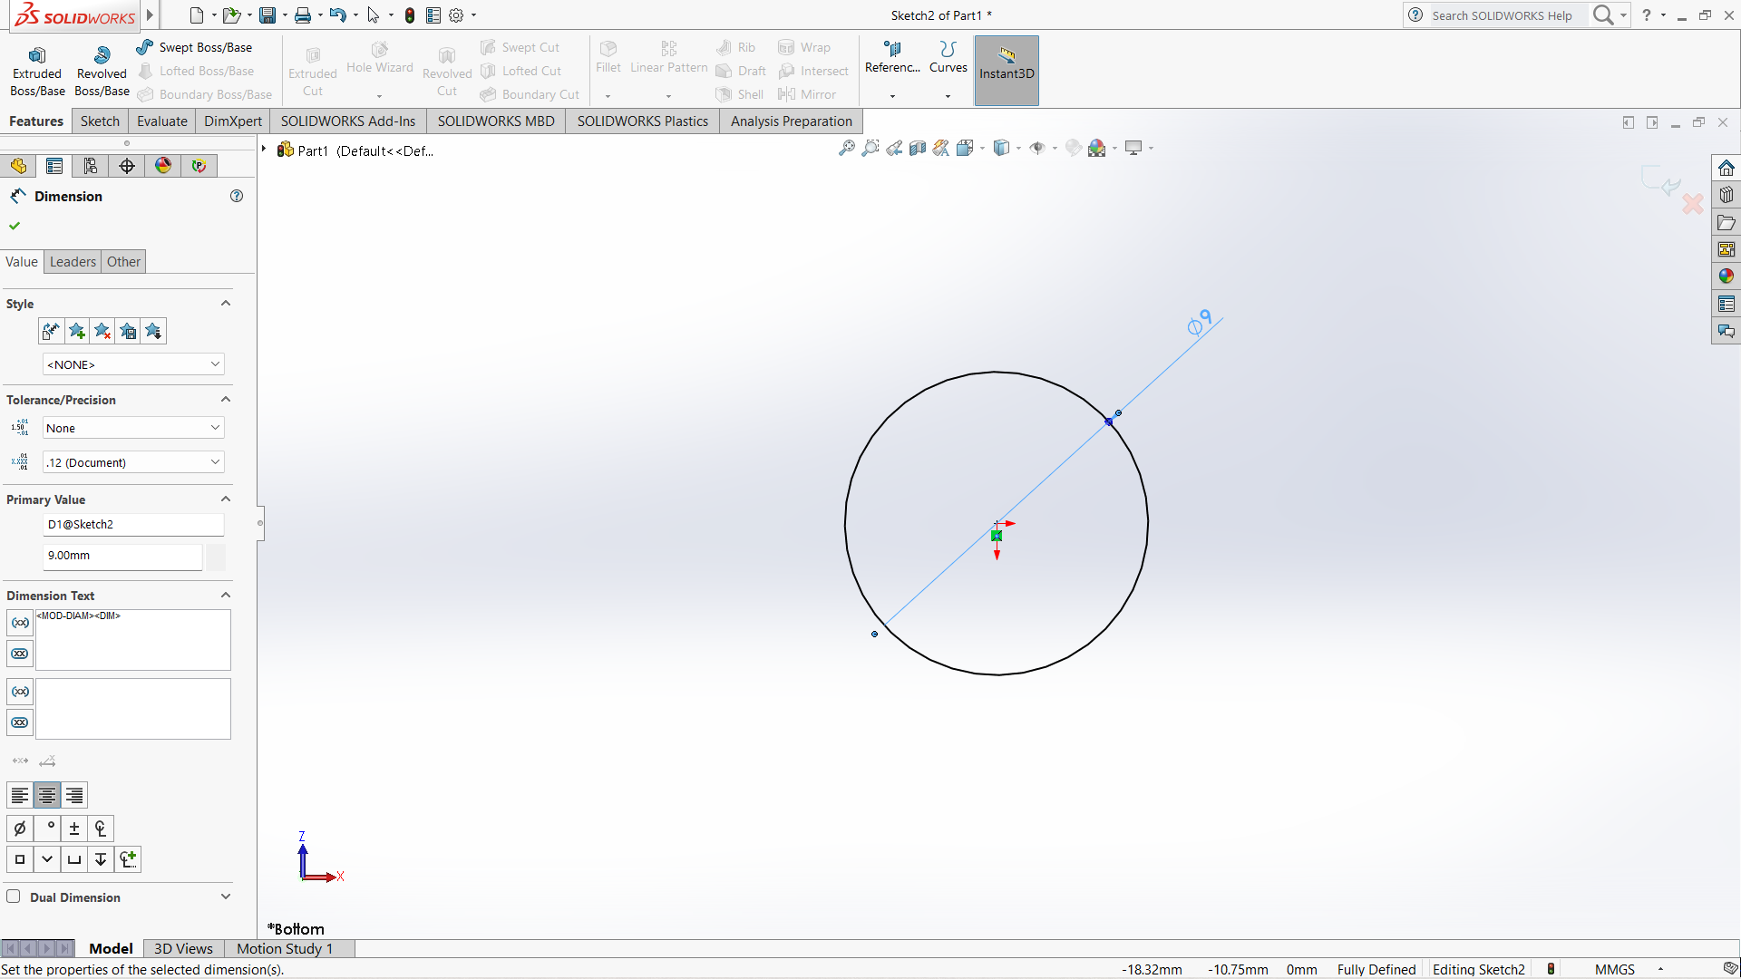

Slide 9
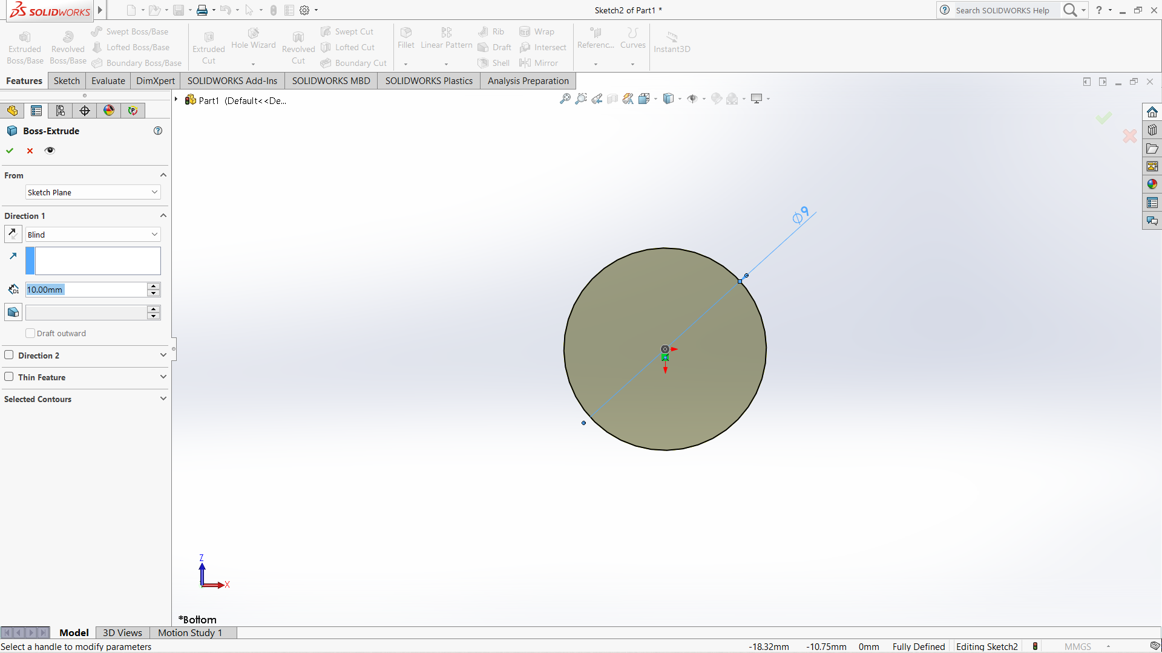

Slide 10
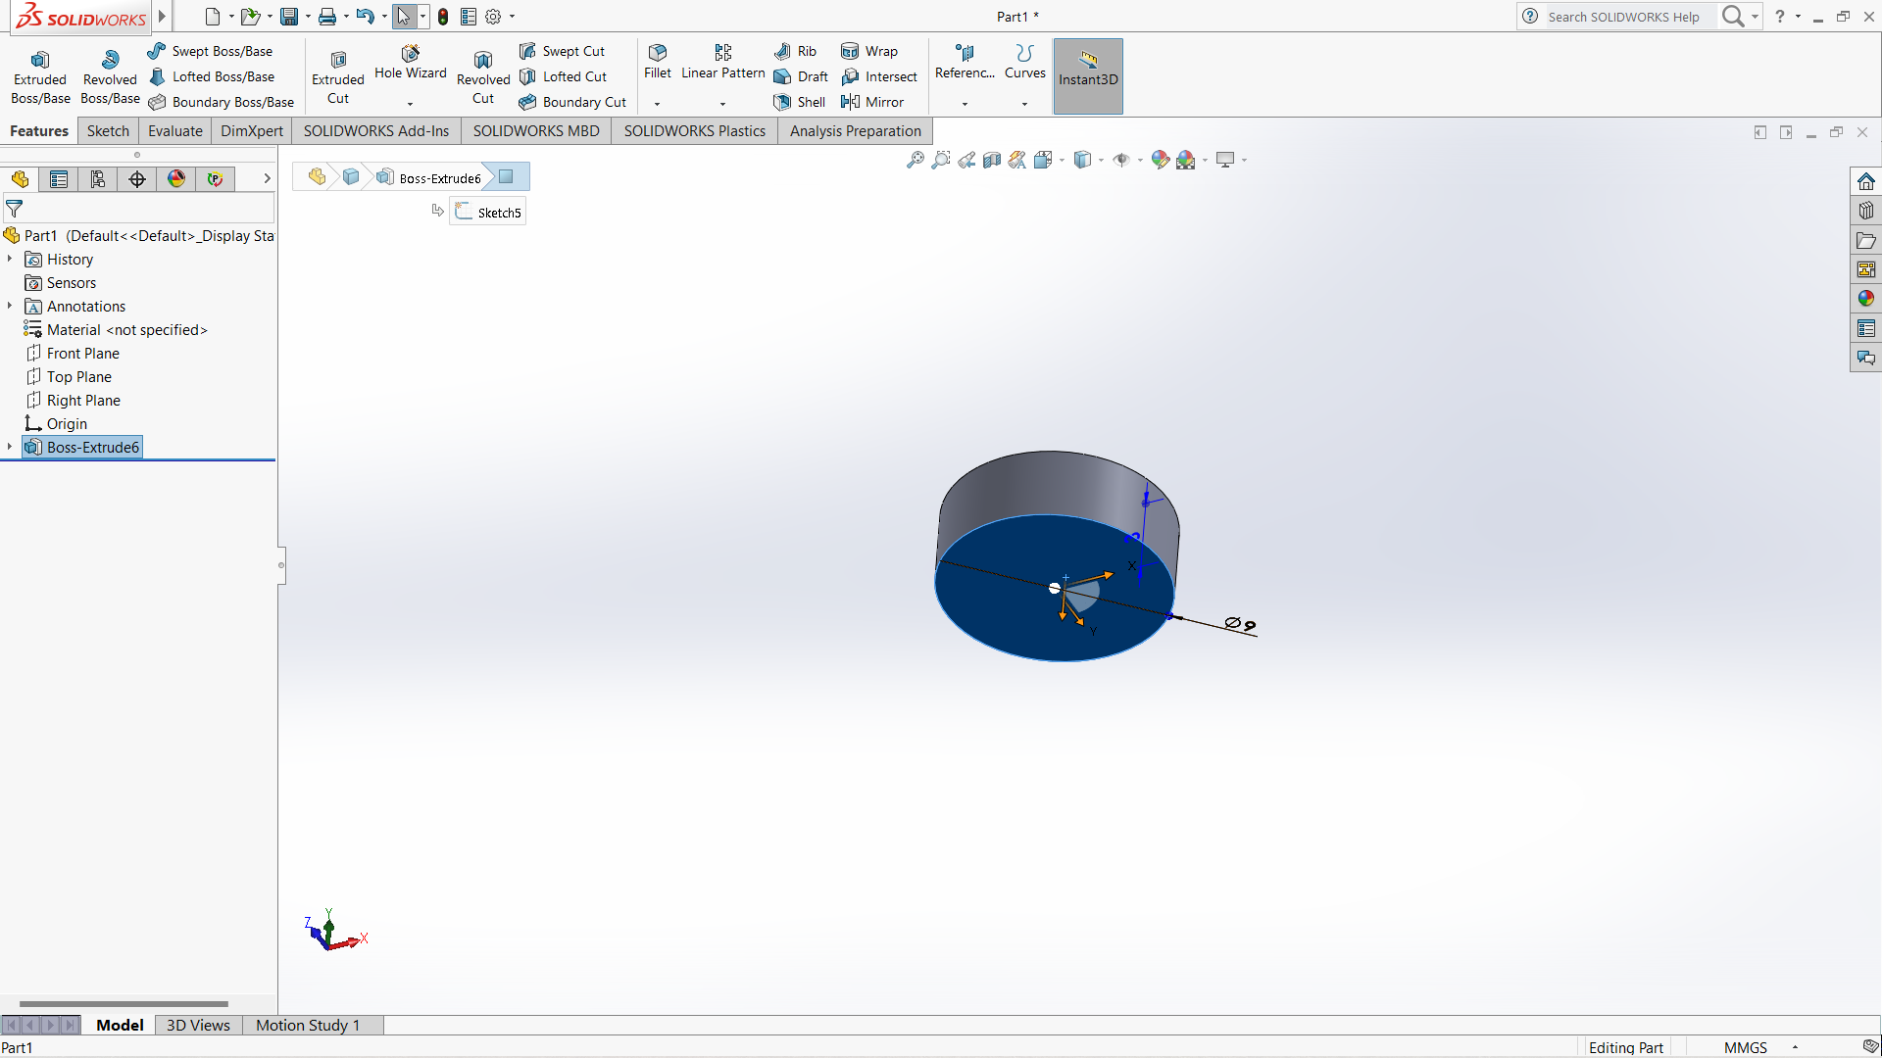

Slide 11
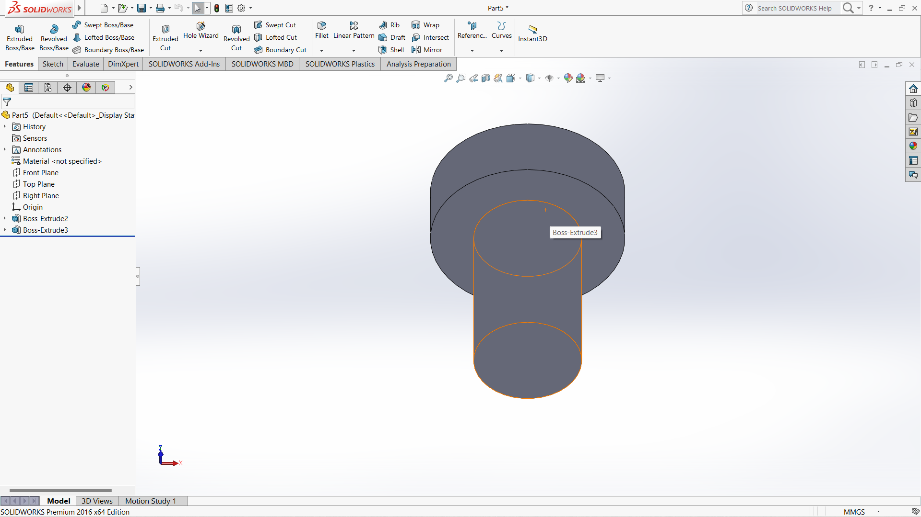

Slide 12
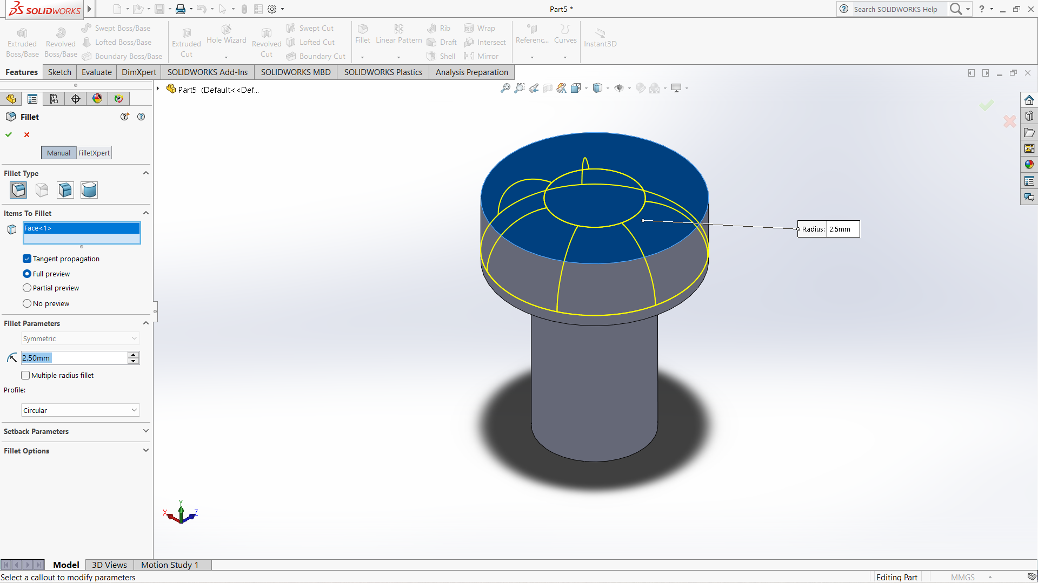

Slide 13
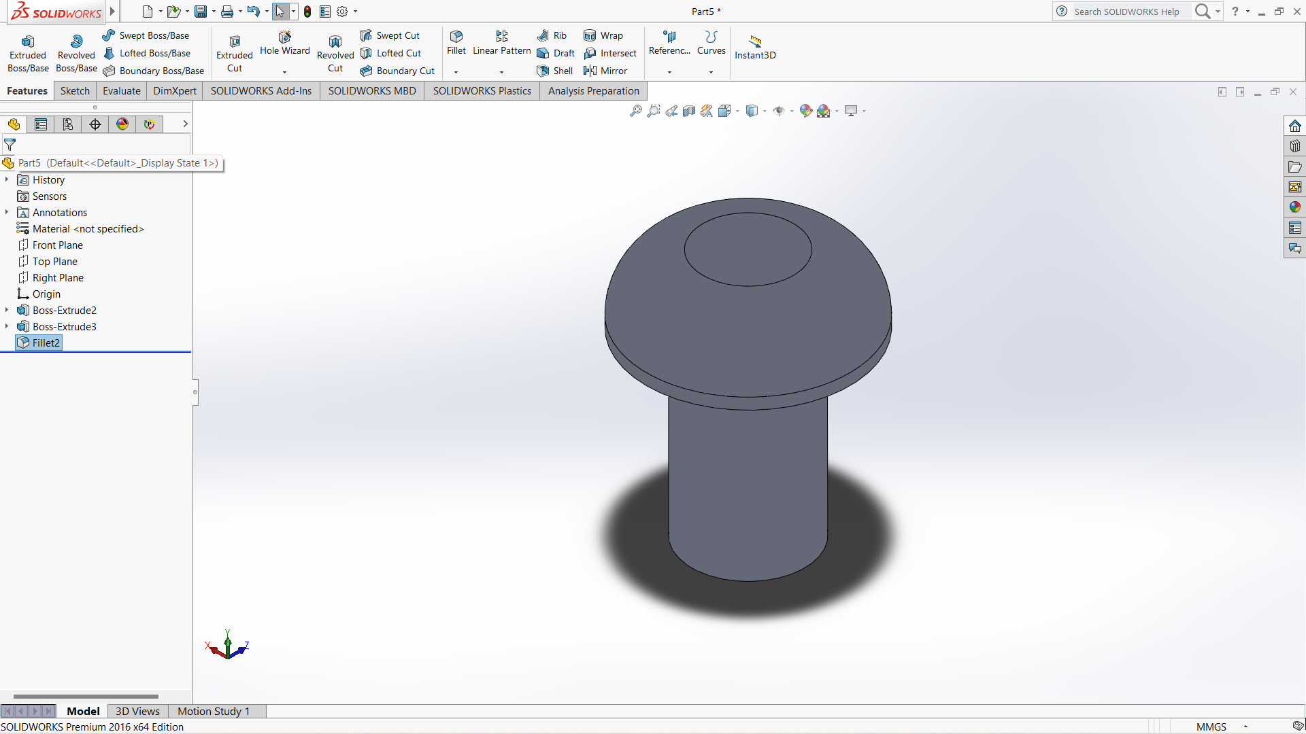

Slide 14
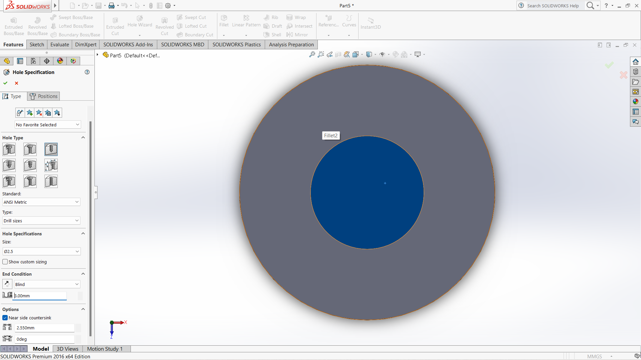

Slide 15
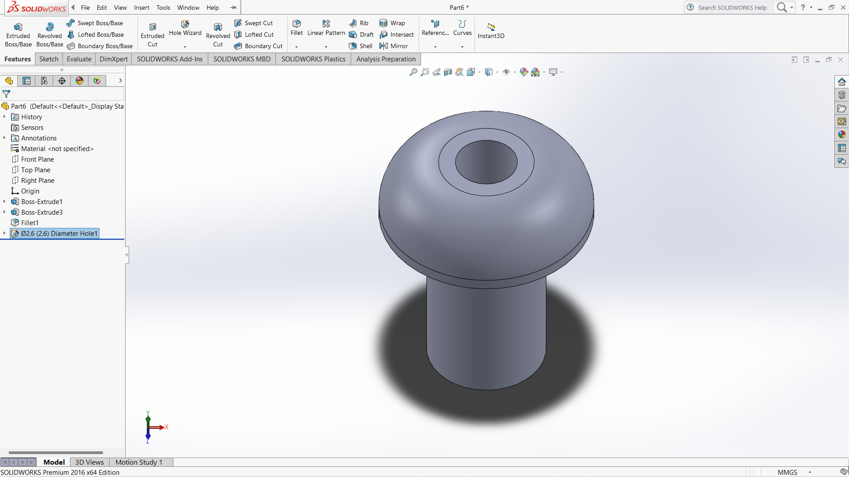

Slide 16
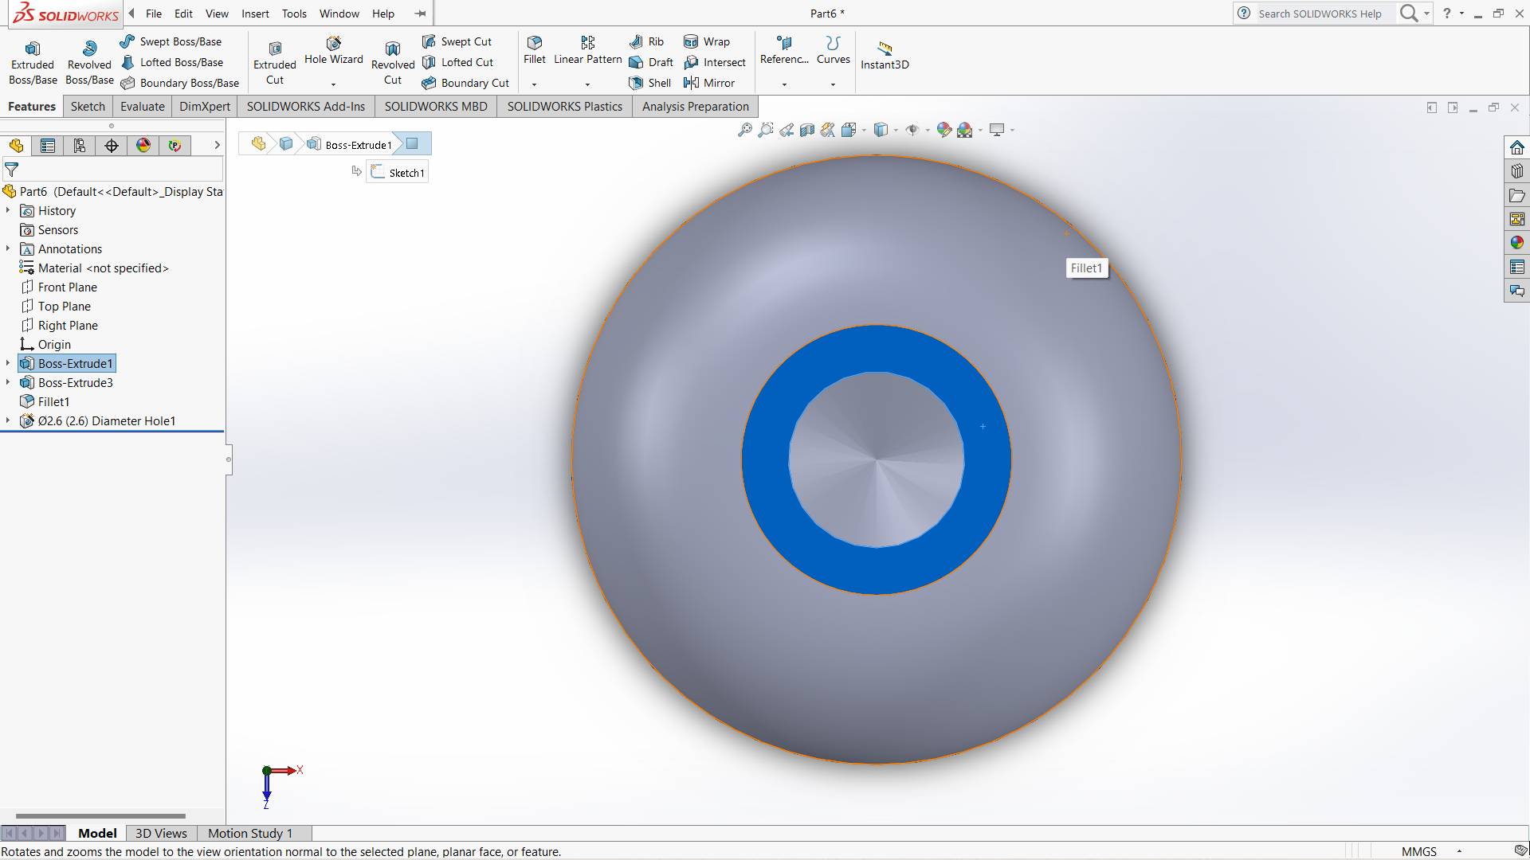

Slide 17
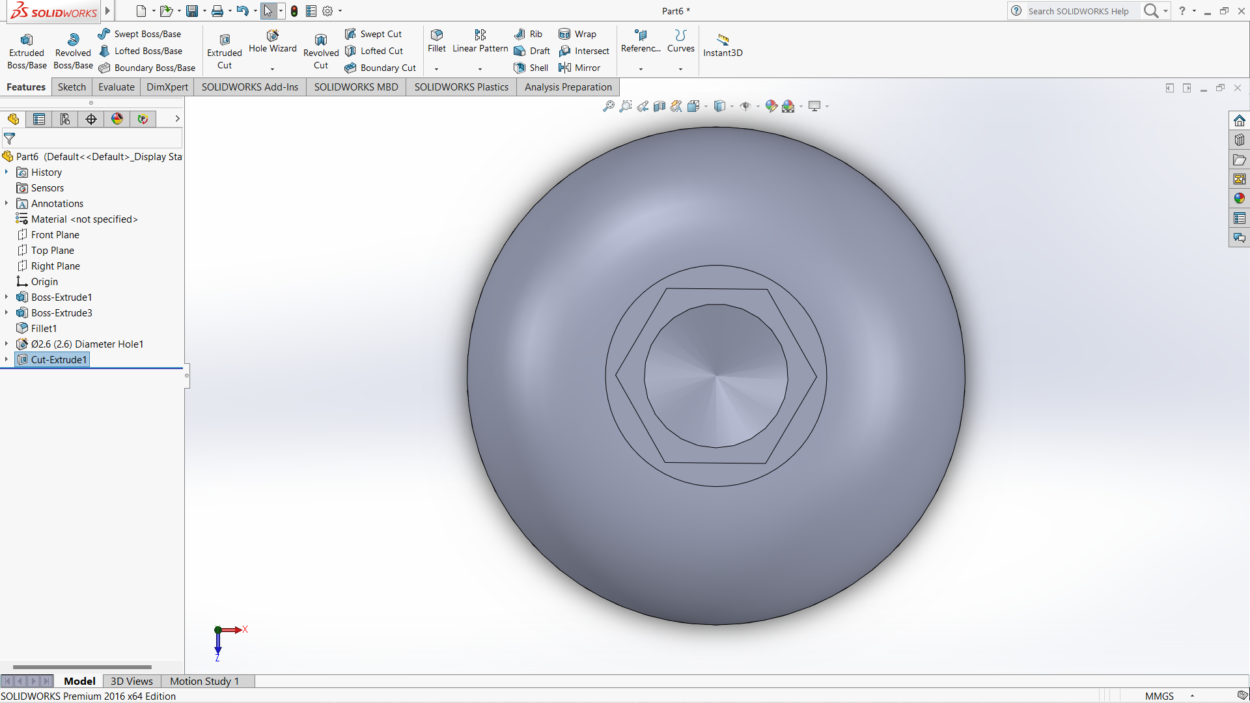

Slide 18
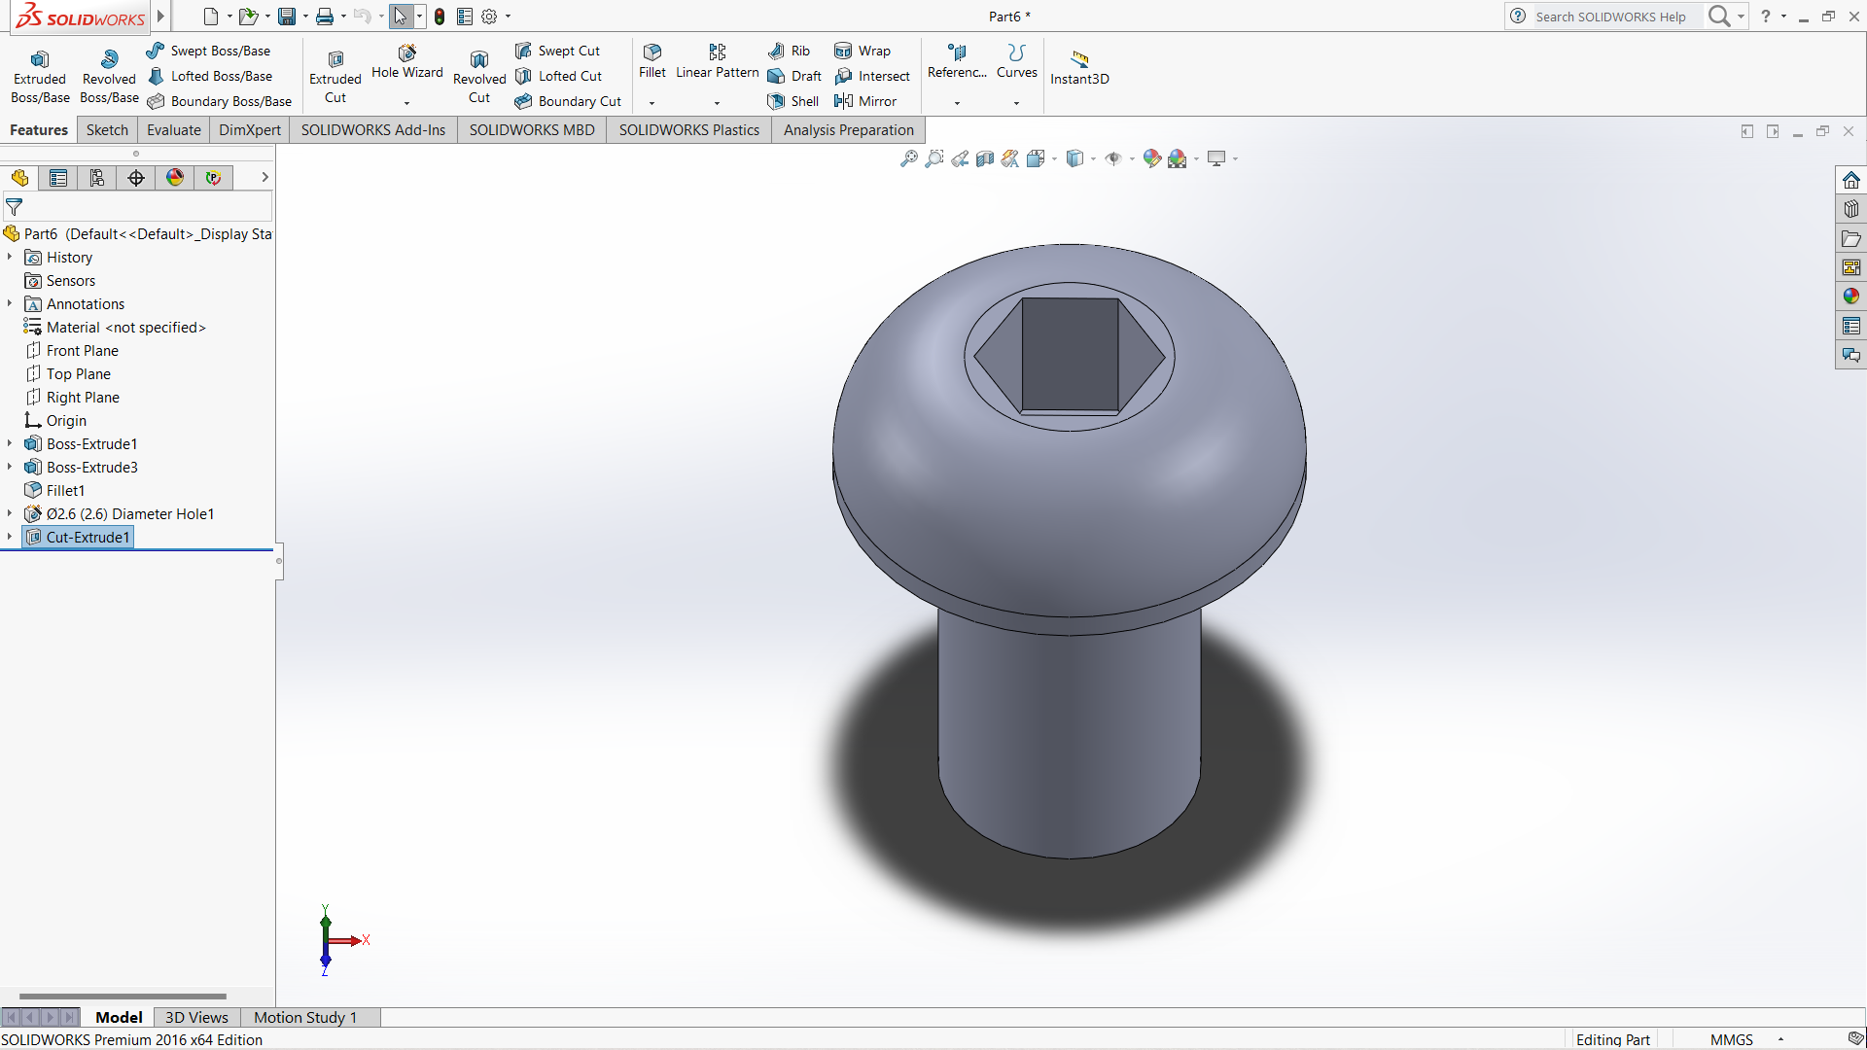

Slide 19
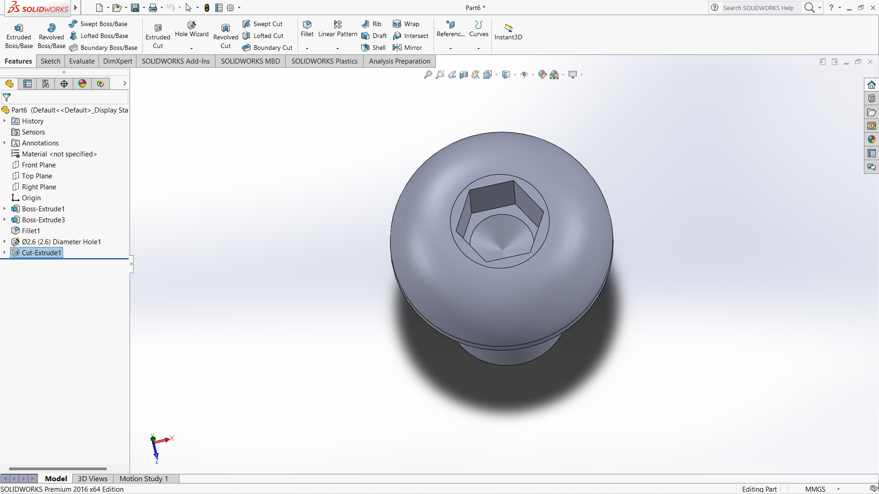

Slide 20
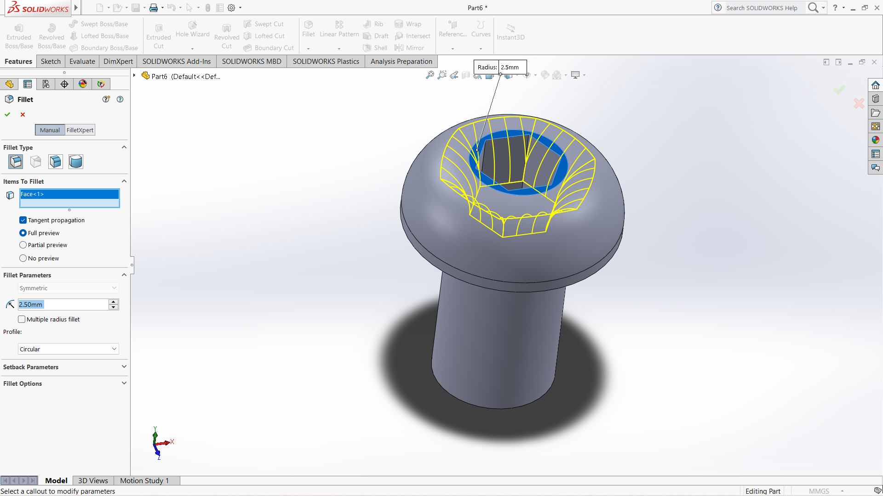

Slide 21
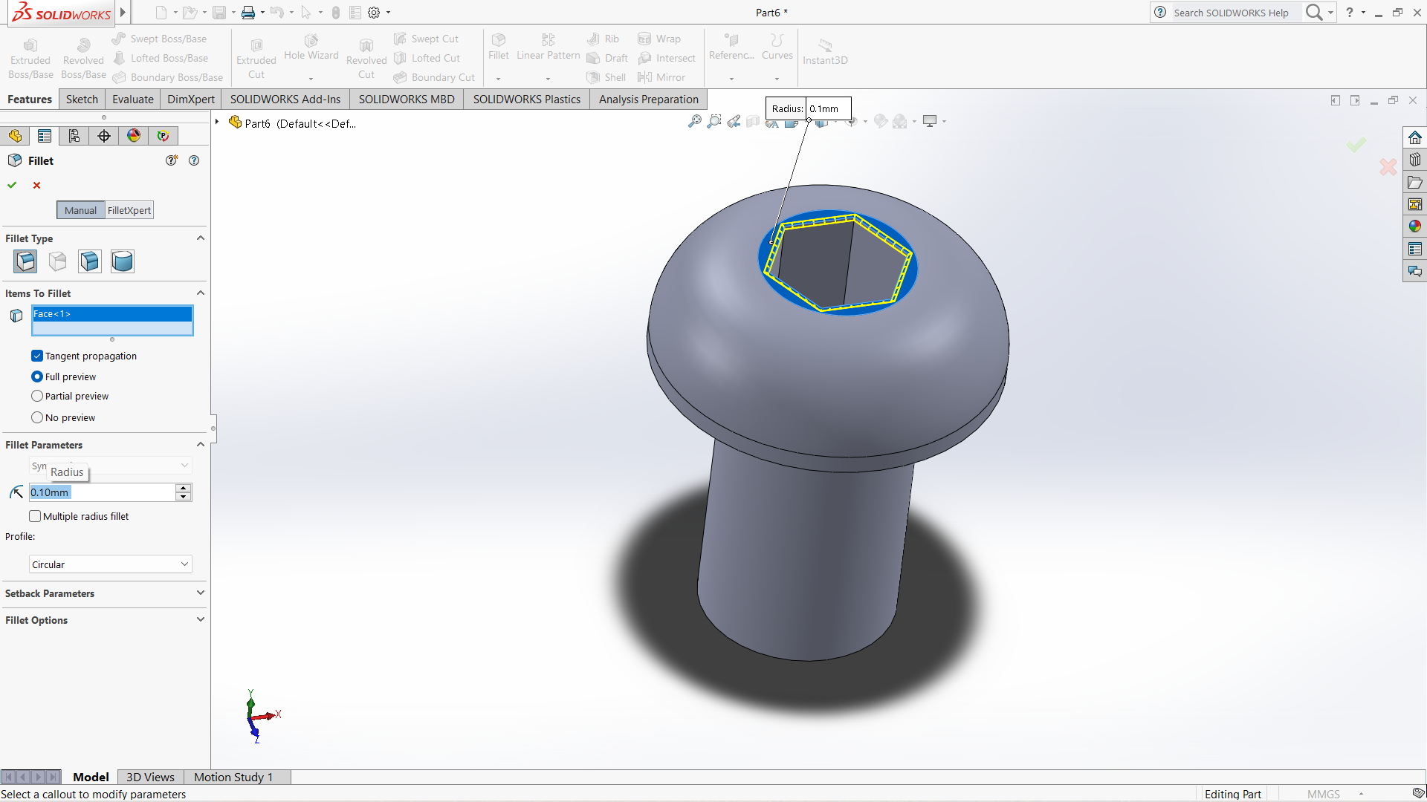

Slide 22
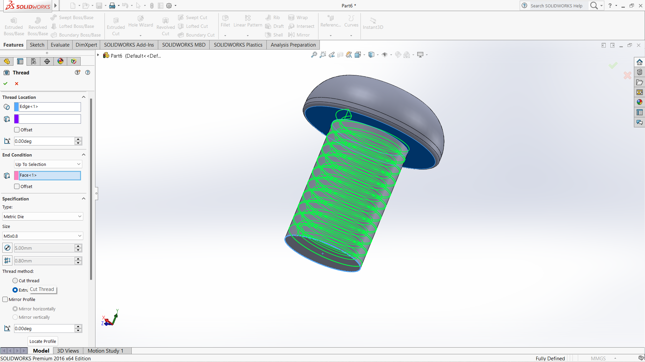

Slide 23
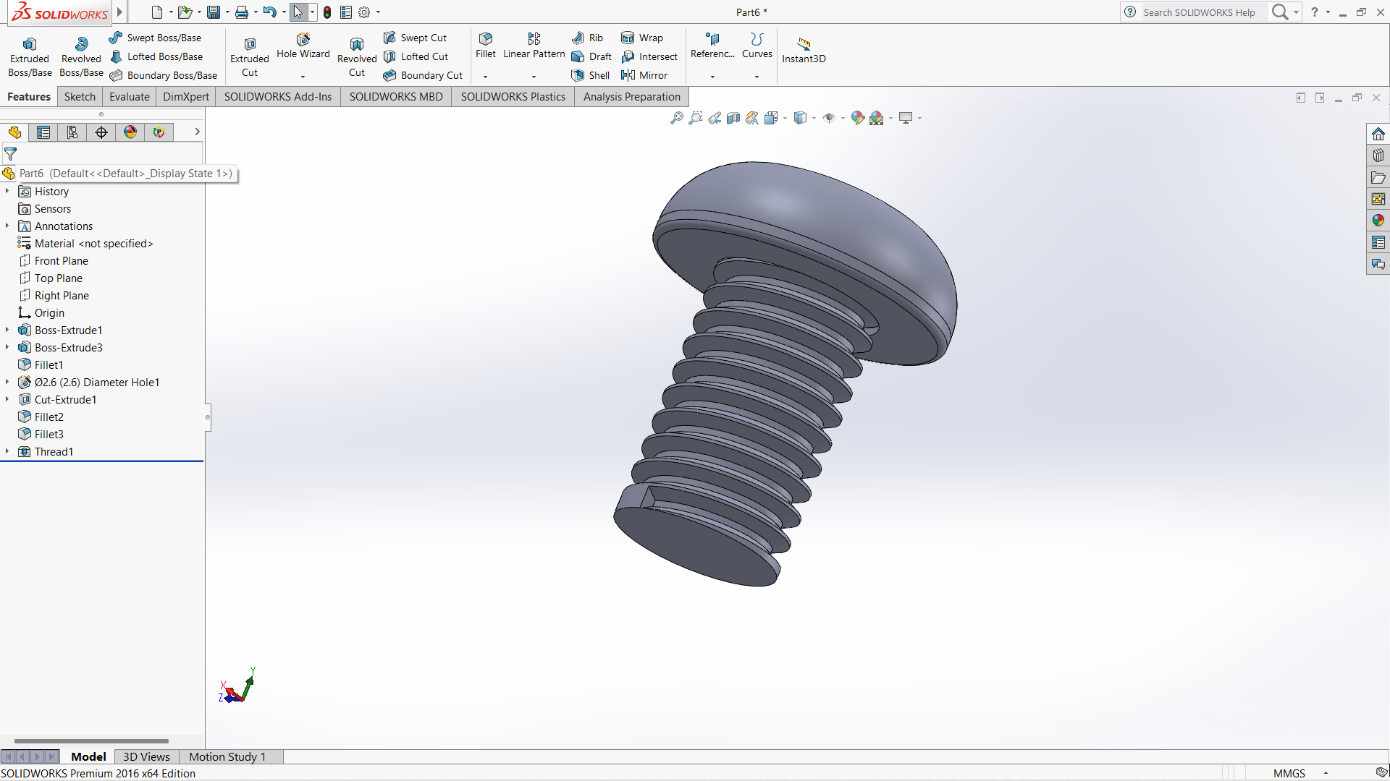

Slide 24
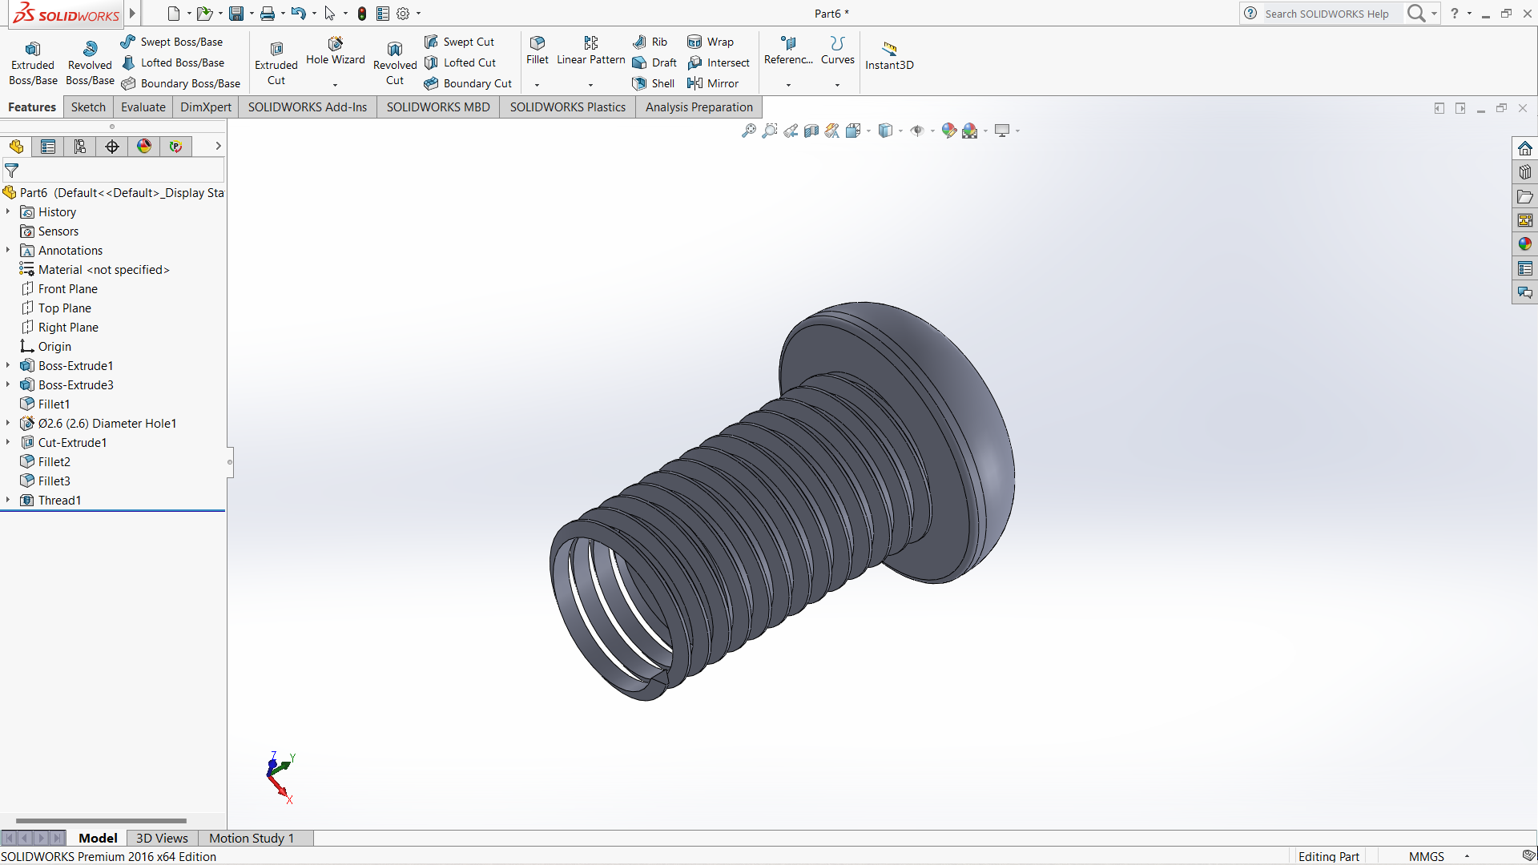

Slide 25
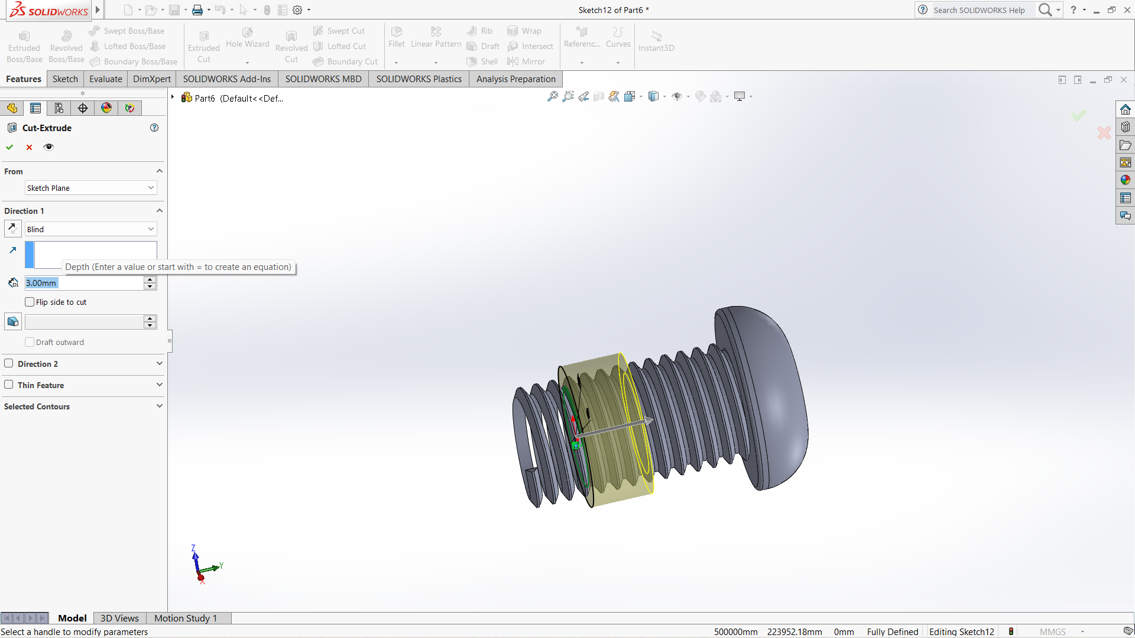

Slide 26
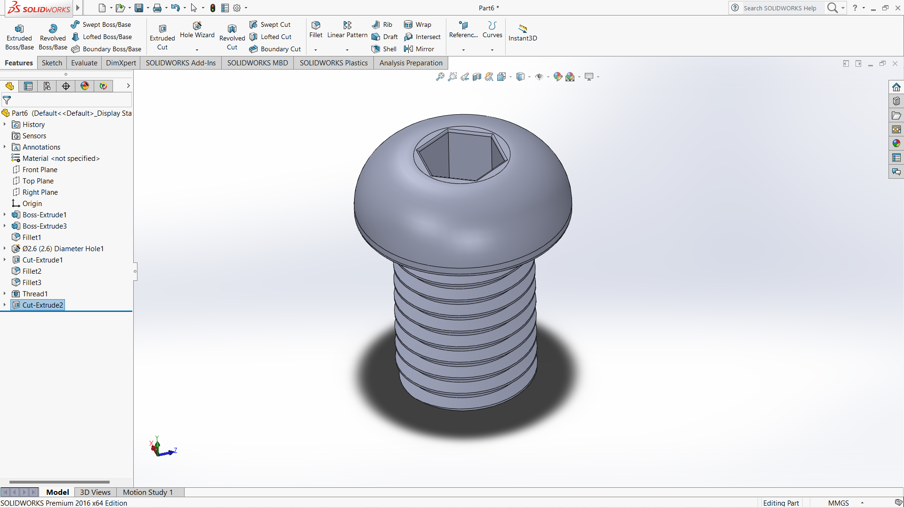

Slide 27
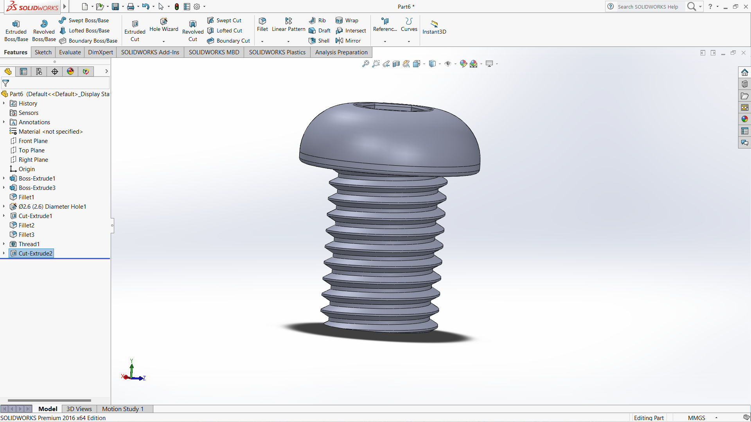

Slide 28
CONCLUSION
•Understanding of need to design models
•Design analysis of 3D animations and photorealistic Rendering.
•Know of how can we take the next steps.
•Part and assembly Modeling.
•Design Reuse and animation
THANK YOU.

